Slide 1
Danda’s Siblings:
Holts, Fuquas, Atchisons, and Shoafs
Holt Huddle 2025 Presentation
Prepared by: Marcia Call
Photo Credits: Richard Holt, Jim Atchison

Slide 2
Table of Contents
Danda’s Parents
Danda’s Siblings and Families
  Sister Allie Holt Fuqua
  Sister Ina Holt Atchison
  Brother Otha Holt

Slide 3
Danda’s Parents
3

Slide 4
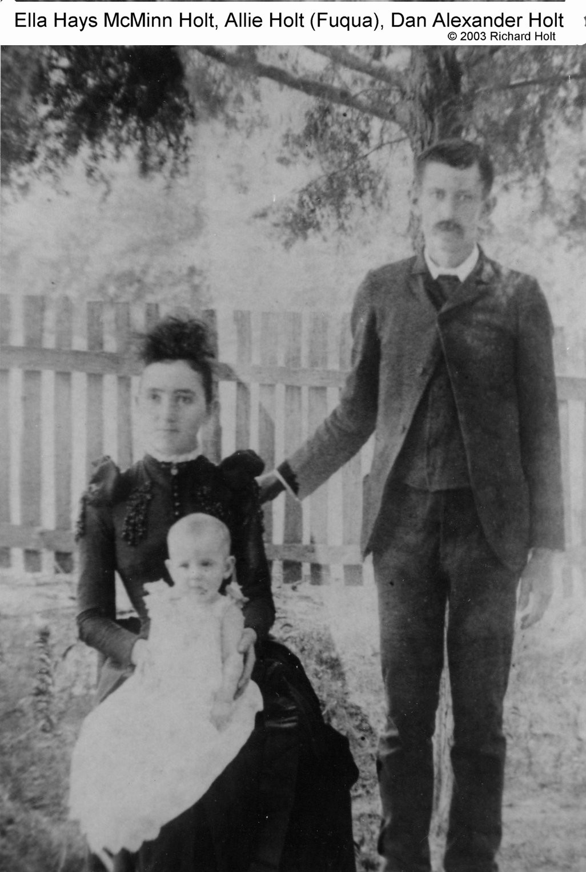
Danda’s Father: Dan Alexander Holt
Born 10 Jun 1866 in Milan, Gibson, Tennessee
1870 Census: His parents had 7 children ages 2-18
  Occupation: Father was a farmer
  Real estate = $1,500 and personal estate = $500 (worth about $39k and $12k today)
1880 Census: His parents had 6 children ages 7-19, father a farmer
Married Ella Hayes McMinn on 31 Jan 1889 in Milan
1900 Census: Dan and Ella plus 4 children from 1-10 years
  Occupation: Farmer
Died 1 Dec 1908 in Milan at 42 of “fever” (typhoid fever)
Buried at Chapel Hill Cemetery in Milan
4

Slide 5
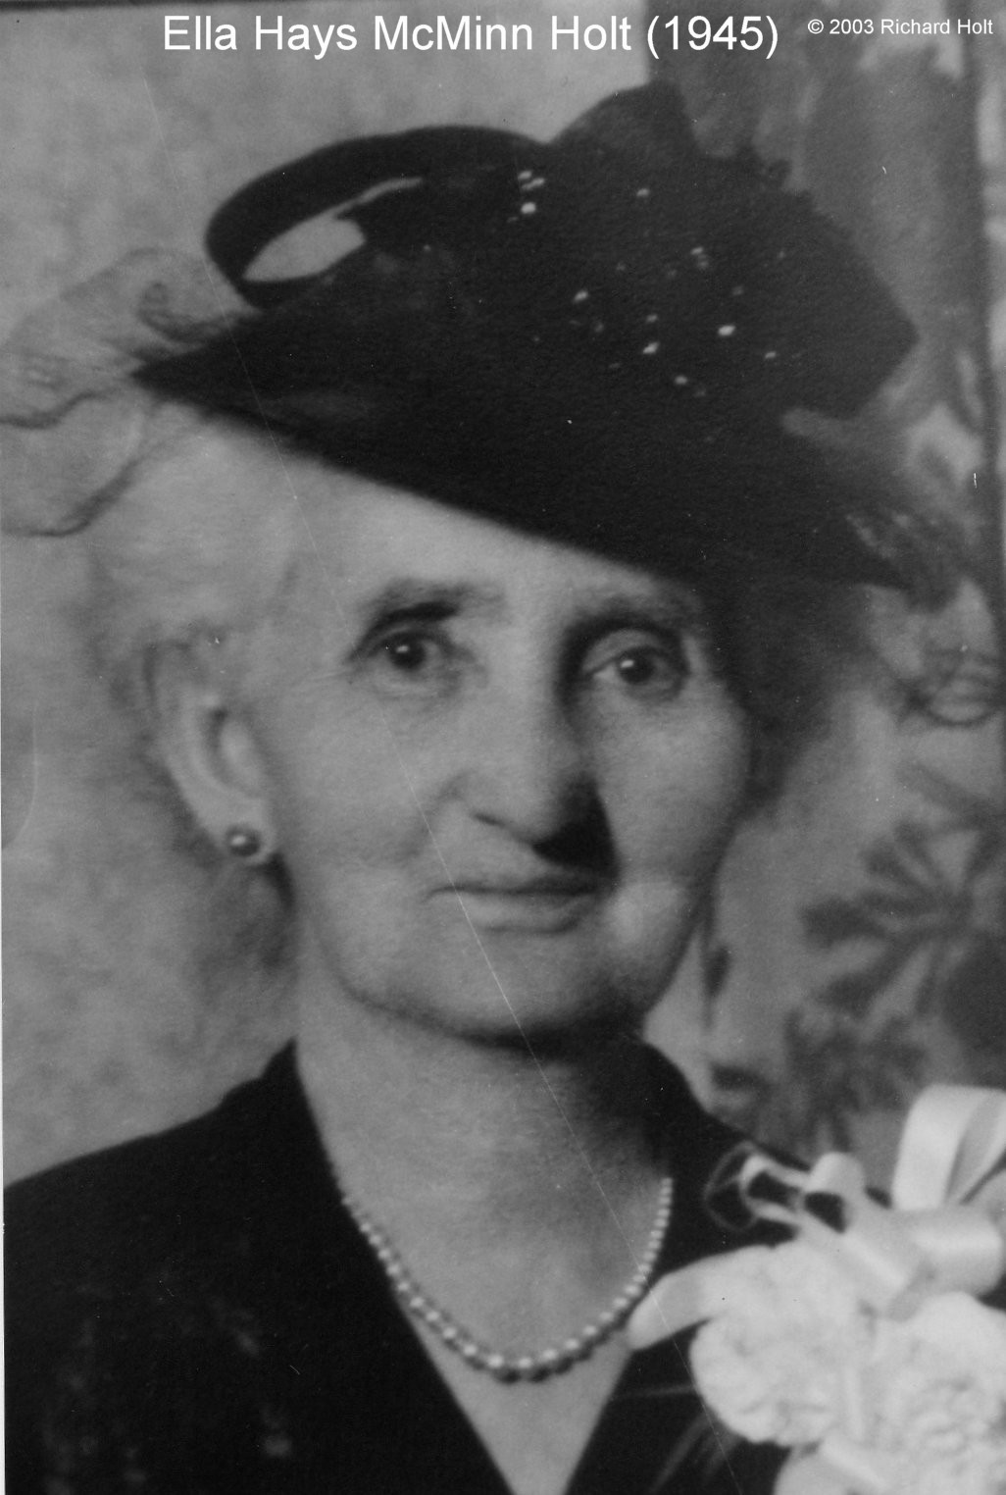
Danda’s Mother: Ella Hays McMinn
Born 6 Aug 1869 in Milan, Tennessee (Obituary)
1870 Census (Carroll County): Her parents had 2 children + mother’s brother
  Father’s Occupation: Farmer
  Real estate = $1,600 and personal estate = $600 (comparable to Dan Alexander’s father’s holdings)
1880 Census (Gibson County): Widowed father with 3 children + father’s sister
  Neighbors to Blankingships, family of wife #2
Married Dan Alexander Holt on 31 Jan 1889 in Milan
1910 Census: Widow with 3 children
  Occupation: Farm manager
  Neighbors to daughter’s family, Allie and Jim Fuqua with son Roy plus McMinns
1920 Census: Head of household, Danda and Danma lived with her + Otha
1930 Census: Head of household, Ina Atchison (35) living with her
1940 Census: Head of household, Ina Atchison and her son Billy (21) living with her
  Real Estate = $1,000 or $19k today
Died 18 Sep 1949 of ”lobar pneumonia” while visiting Danma and Danda
Buried at Chapel Hill Cemetery in Milan
5

Slide 6
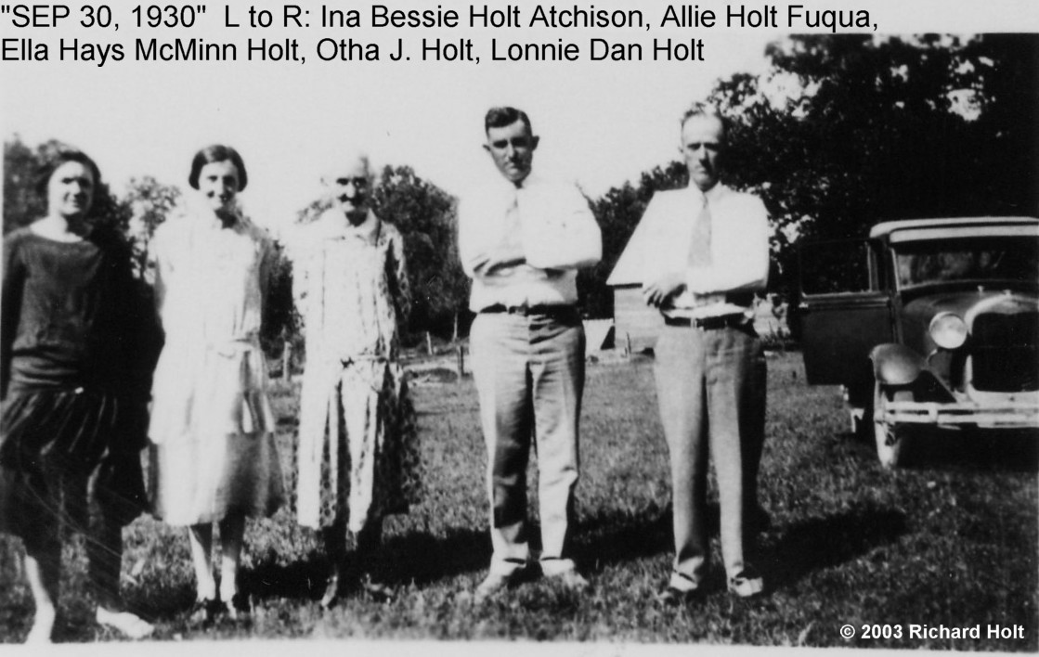
Children
Dan and Ella had 4 children:
Emma Alene (Allie) Holt Fuqua born 1889 - died 1967
Ina Bessie Holt Atchison born 1893 – died 1983
Lonnie Dan Holt (our Danda) born 1896 – died 1974
Otha John Holt born 1899 – died 1974
6

Slide 7
Danda’s Siblings and Families
7

Slide 8
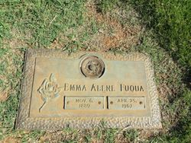
Born 6 Nov 1889 in Milan, Gibson, TN
James William Fuqua executed a marriage bond of $1,250 on 22 Dec 1908 in Gibson County, TN
1910 Census (Milan, TN): Family of 3 (Roy)
  Occupation: Jim was a farmer
1920 Census (Birmingham, AL): Family of 5 (Roy, Margaret, and Kathleen)
  Occupation: Electrician
1930 Census (Birmingham, AL): Family of 9 (Roy Dan, Margaret Ella, Ina Kathleen, James William Jr., Bennett Holt, Jennett Hayes, and Allie Louise
James died 21 Aug 1962 in Birmingham
Allie died 25 Apr 1967 in Birmingham
Both are buried at Elmwood Cemetery in Hartselle, Morgan County, Alabama
SISTER: Emma Alene “Allie” Holt
8

Slide 9
Allie’s Children
Roy Dan, 1909-1980
Margaret Ella, 1912-1987
Ina Kathleen, 1917-1993
James William Jr., 1921-1971
Bennett Holt, 1923-2001
Jennette Hayes,1923-1990
Allie Louise, 1926-1998
Is anyone in contact with their descendants?

Slide 10
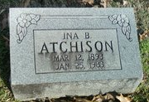
Born 12 March 1893 in Milan, Gibson, TN
Ina, “a popular young school teacher” married Jimmie C. Atchison “a well-to-do young farmer” on 27 Dec 1917 in Gibson County
1920 Census: Family of 4 living in Gibson County (son Billy and Jimmie’s mother Emma)
1930 Census: Family of 5 living in Gibson County (sons Billy and Quinton plus Jimmie’s mother Emma)
Showed signs of serious mental illness – spent time in Western State Mental Hospital, Bolivar, TN
1940 Census:
  Jimmie was listed as widowed and living with son, Quinton, and mother, Emma
  Ina was listed as widowed and living with son, Billy and mother, Ella; she is listed as “Unable” to work
Jimmie, a WW1 veteran, died 27 Apr 1945 in Memphis and is buried in Centerville Cemetery in Medina; Denton Fly was a pall bearer
1949 Ina’s mother died: from then forward Ina lived with Danma and Danda
Ina died 25 Jan 1983 and is buried in Chapel Hill Cemetery in Milan
SISTER: Ina Bessie Holt

Slide 11
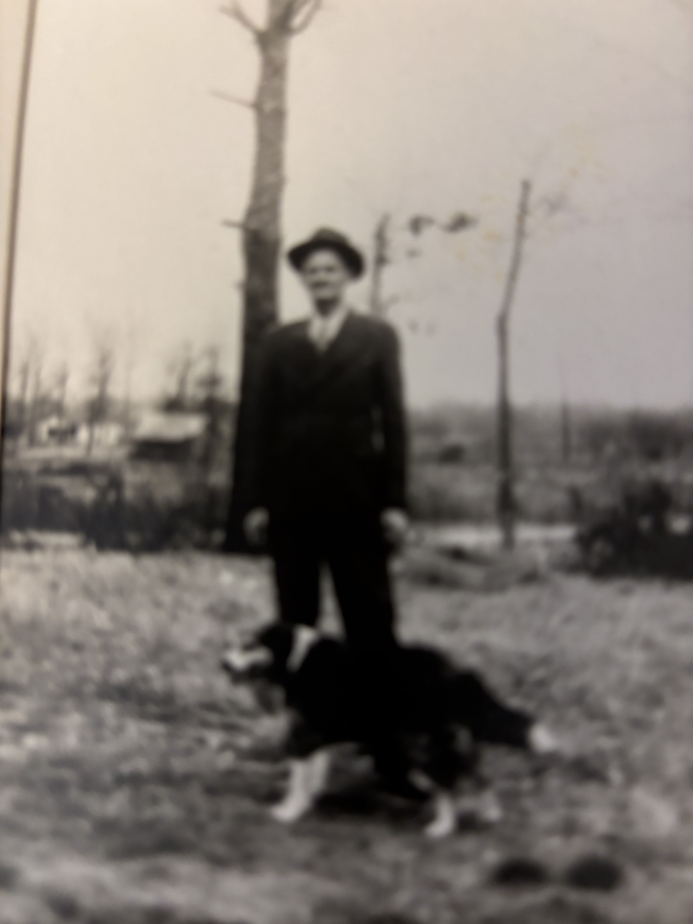
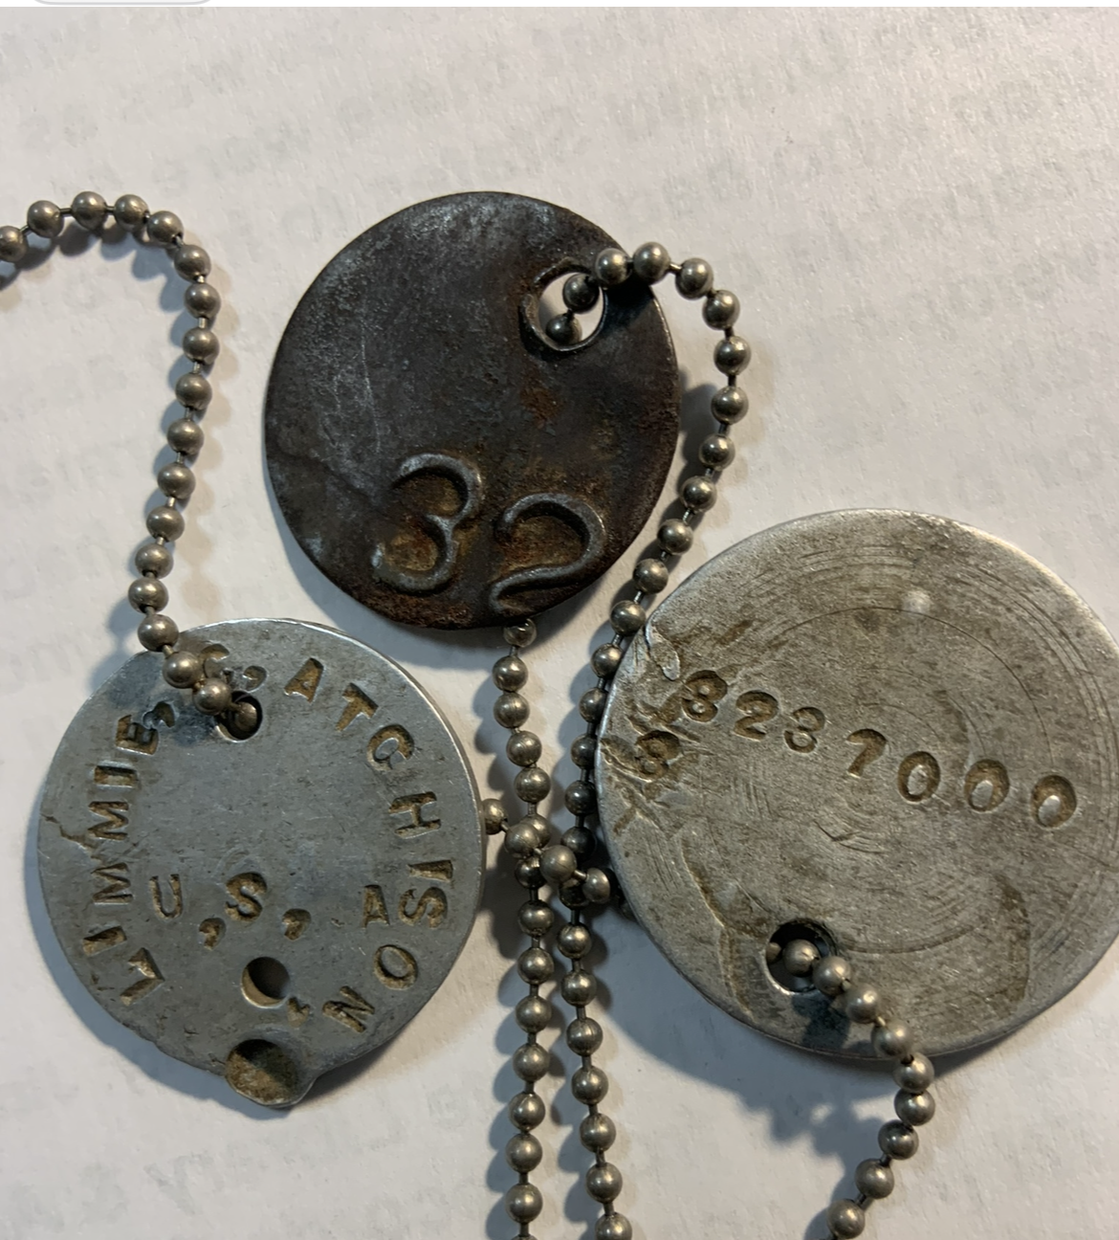
Ina’s Husband, Jimmie C. Atchison
Jimmie’s WWI Dog Tags
Jimmie and Rex

Slide 12
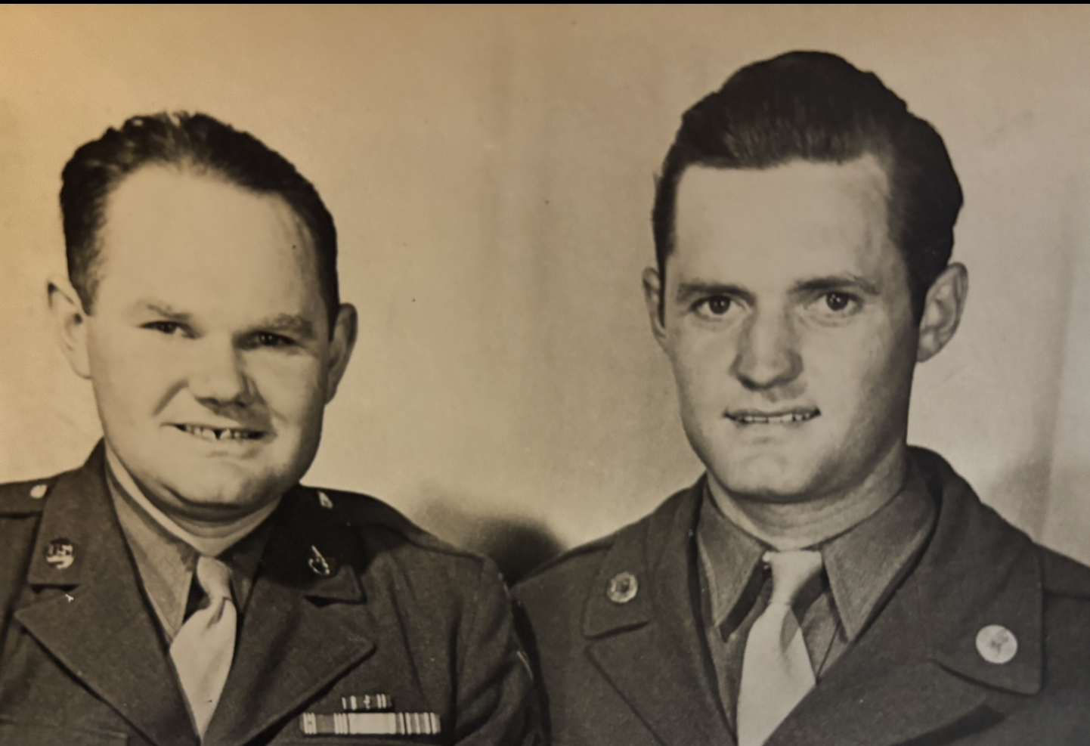
Ina’s Children
James William ”Billy”, 1918 – 1987
Quinton Clyde, 1920 - 1976

Slide 13
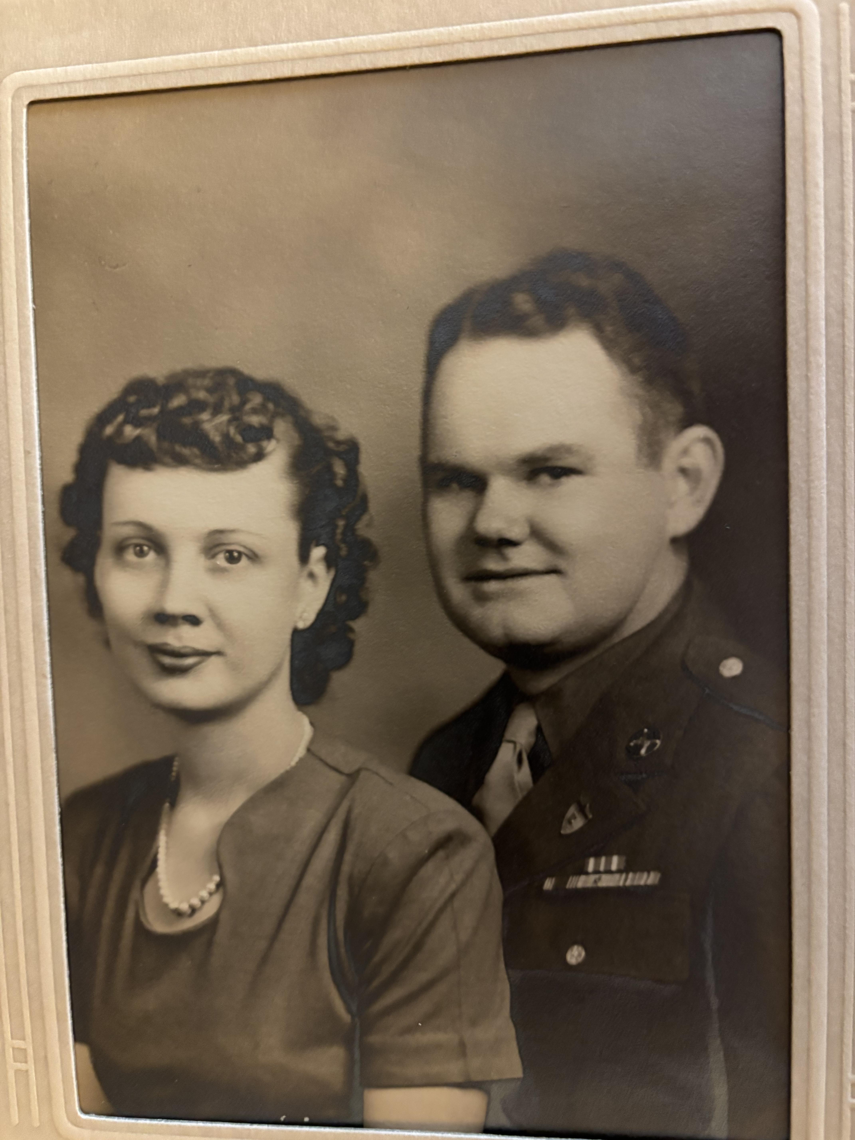
What we know about Billy
Born 12 October 1918 in Milan, Gibson, TN
Registered for WWII draft, October 1940
  5’9”, 187 lbs, Blue eyes, Brown Hair, Ruddy Complexion
  Next of kin: Jimmie C. Atchison
  Ethel Mills (B.D. Mills wife, Danma’s sister) was registrar!
  Reported to Fort Oglethorpe, Georgia, Warrant Officer Corps, U.S. Army
Married Alberta Sue Miles from Martin, TN, on 4 November 1944
Admitted to military hospital in March 1945 for a month to treat acute bronchitis
Home 20 September: lived in home of deceased father, Jimmie C. Atchison
Had 3 sons – Jim, Bobby, and Don
Worked as a carpenter
Alberta worked outside home after boys went to school: doctor’s office, Milan Arsenal during Vietnam War, Milan Mirror
Billy died 17 January 1987, and Alberta died 26 February 2015
Both are buried in Centerville Cemetery, Medina, Gibson, TN
Alberta Sue and Billy

Slide 14
Billy Atchison’s
Children
James Albert, 1946
  Married Charlotte Dennison in 1968
  2 Daughters/5 Grandchildren/1 Great Grandson
    Tara Atchison/Kurre Thomas Luber, MD, 1996: Kurre Thomas Jr., Miles Atchison, Charlotte Allen
    Abigail Atchison/John Kevin Irions, 1995: Emma Kate, Elizabeth Reagan
      Emma Kate/Dustin Johnson: Gunner Pate
Robert Frank, 1947-2023
  Married Brenda Sellars in 1972
  2 Daughters/3 Grandchildren
    Courtney Atchison: severe special needs
    Meredith Atchison: Juliana Lisette, Aiden Clark, Everly Blair
Don David, 1949
  Married Claudette Williams Bentley
  2 Sons/3 Grandchildren
    Andrew James/Amanda: Autumn Everly
    Christopher Wade Bentley/Melissa: Amanda Marie, Abigail Elaine

Slide 15
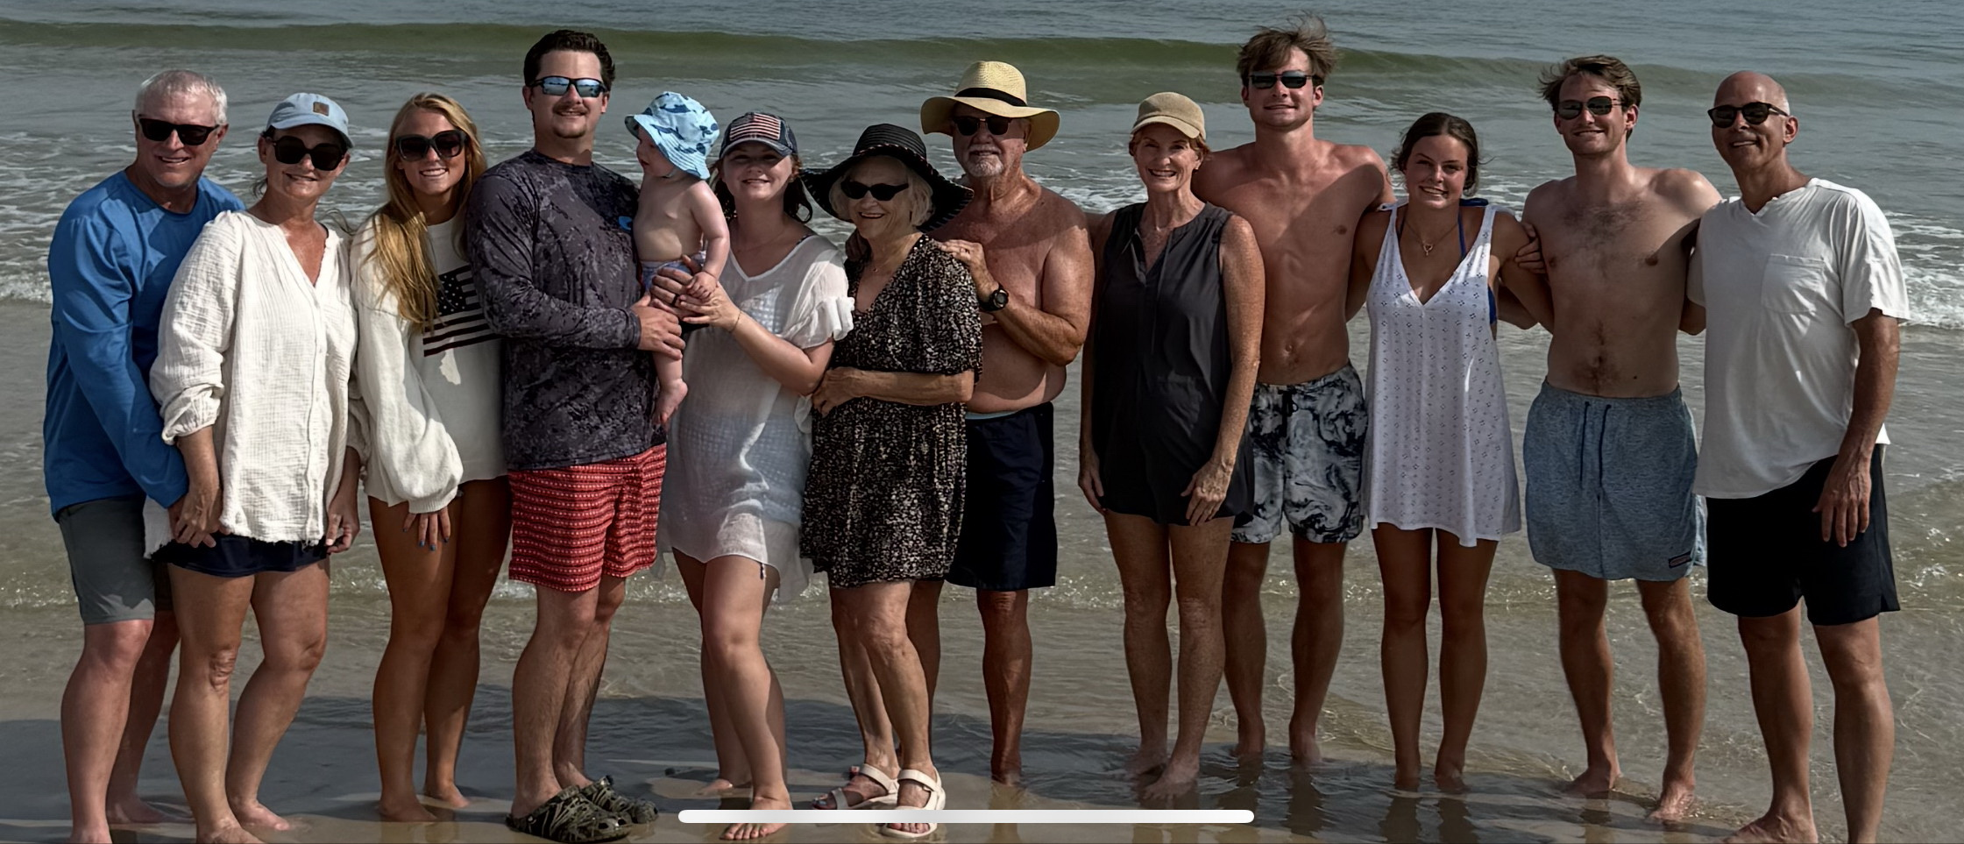
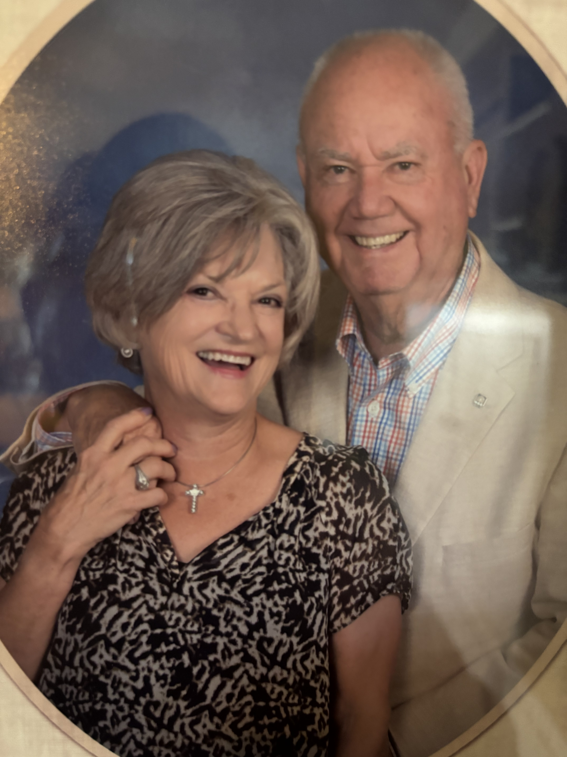
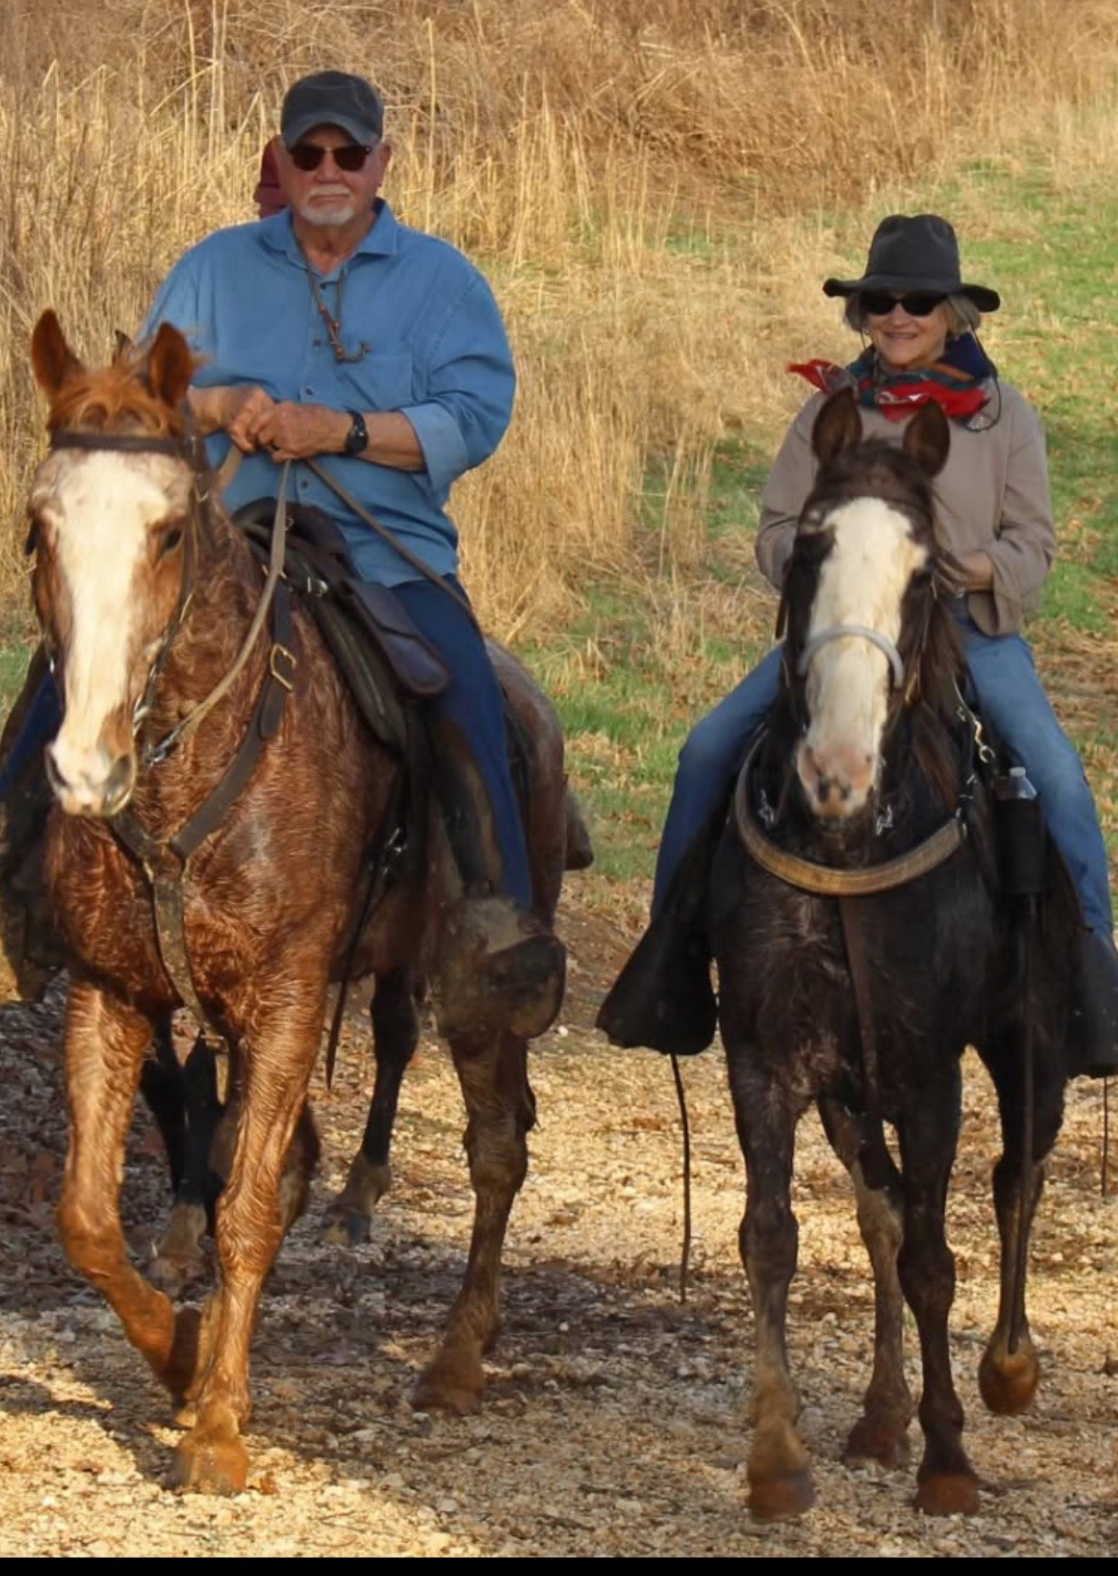
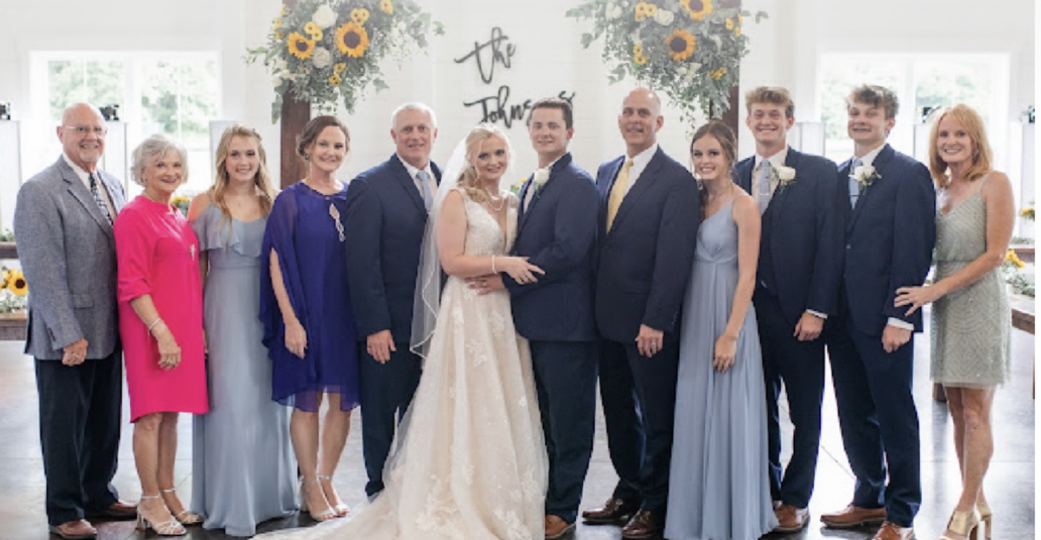
2025
Jim Atchison Family Photos
Family Wedding

Slide 16
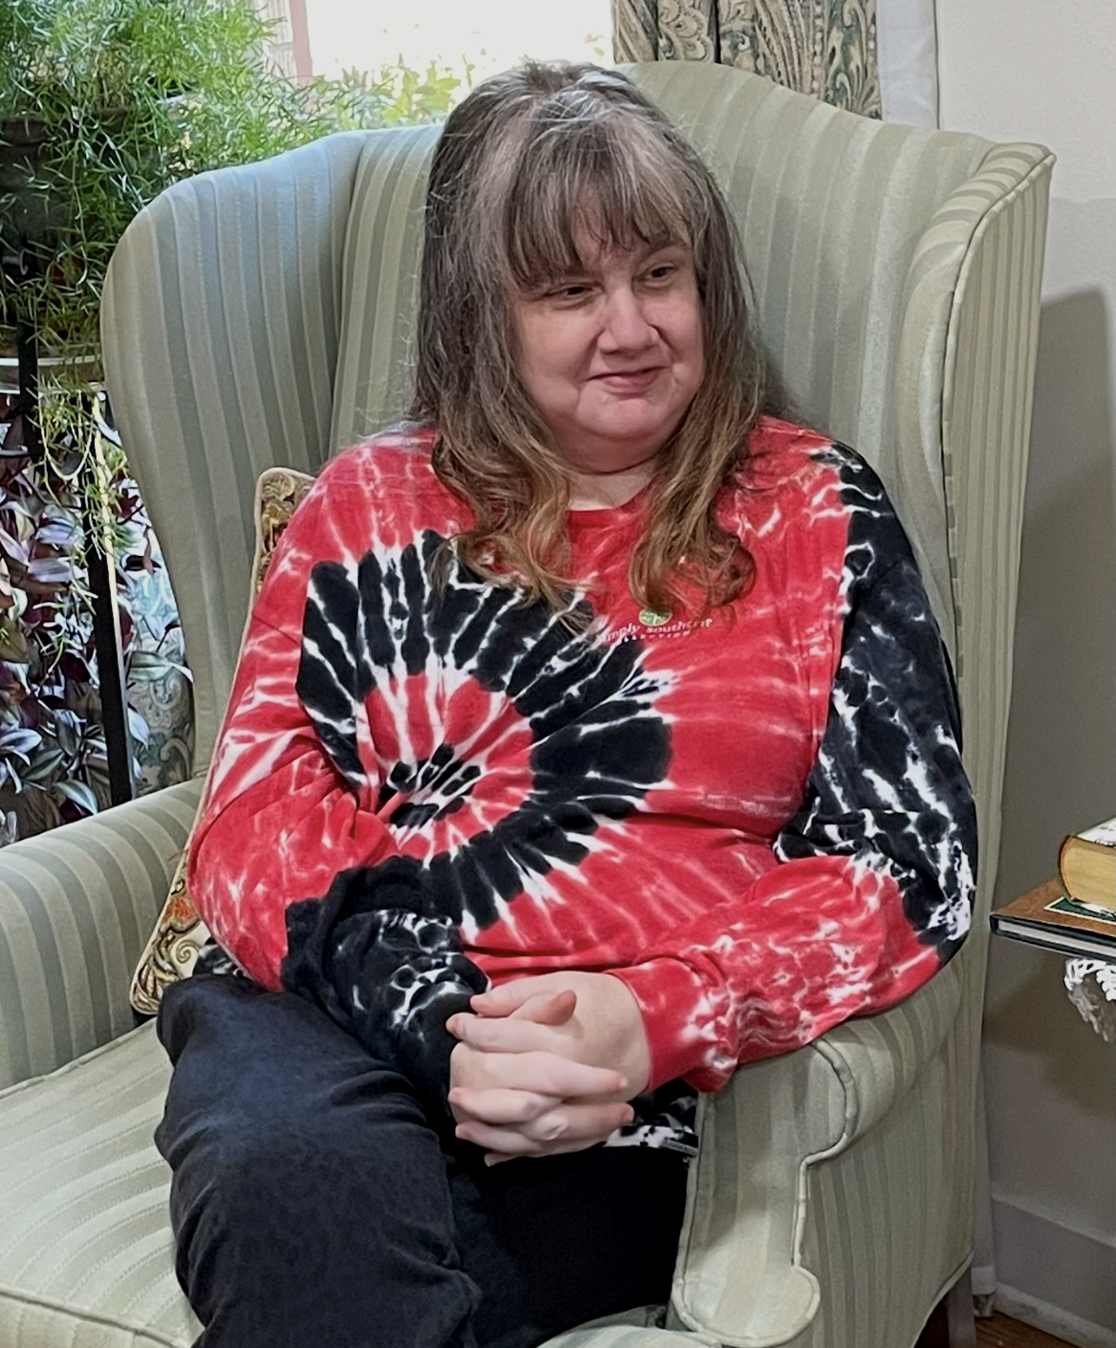

Meredith Blair Atchison, Juliana, Aiden, and Everley
Courtney Beth Atchison
Bobby Atchison Family Photos

Slide 17
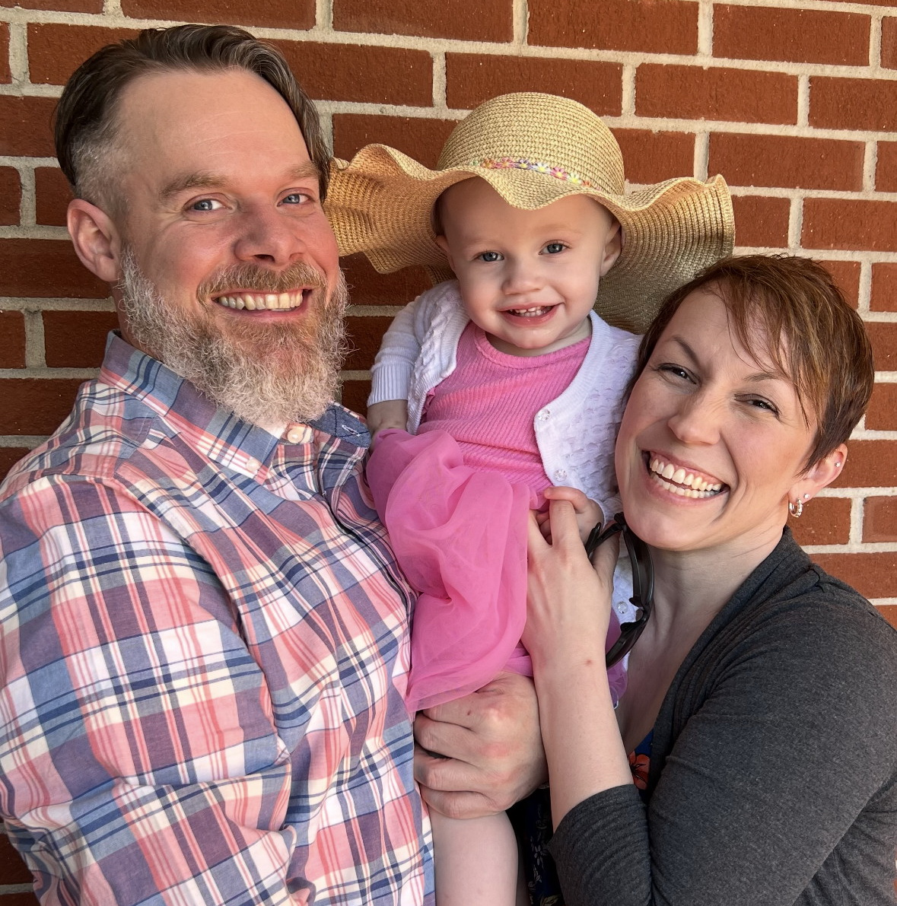
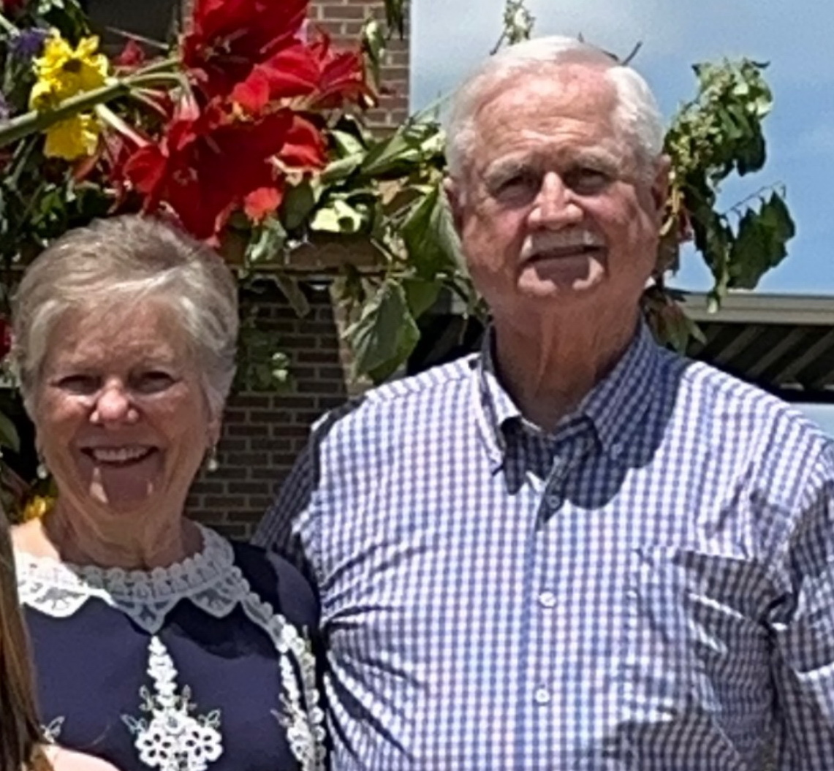
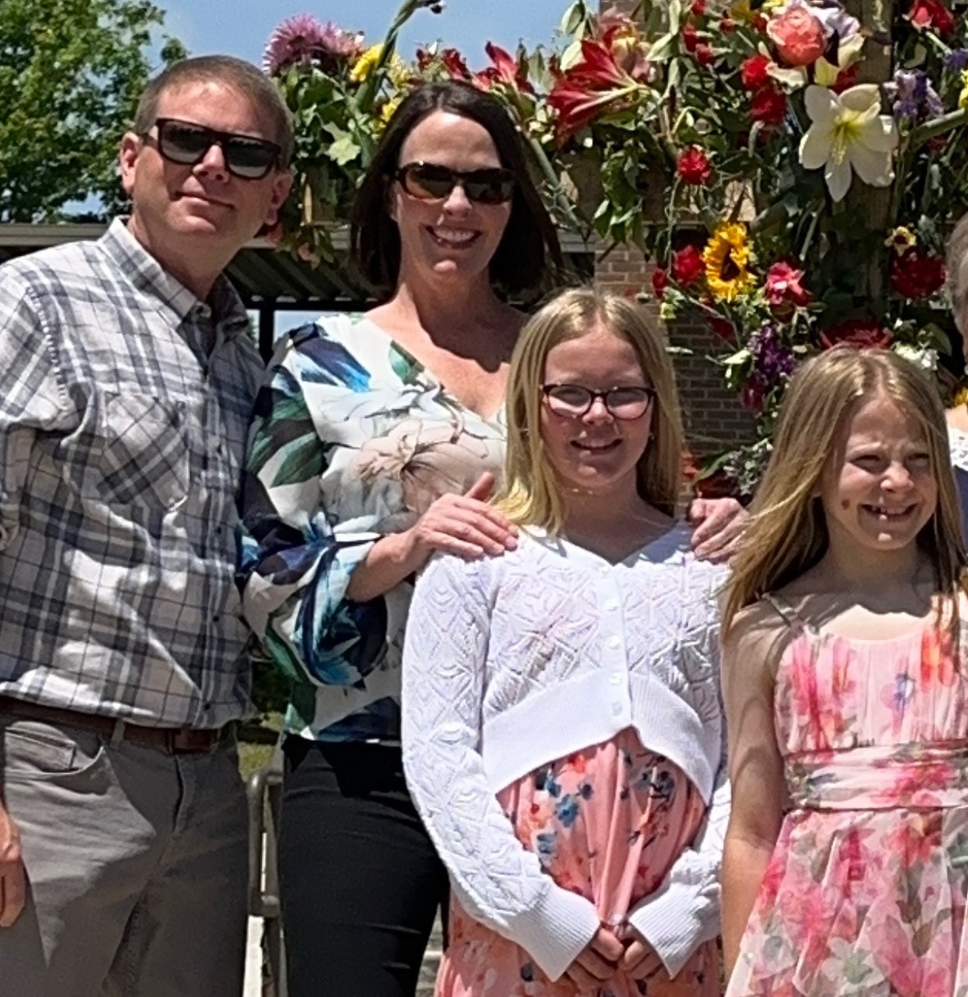
Chris, Melissa, Abigail and Amanda Bentley
Andrew, Amanda, and Autumn Atchison
Don Atchison Family Photos

Slide 18
What we know about Quinton
Born 22 April 1920 in Milan, Gibson, TN
Registered for WWII draft, 1 July 1941
  6’1”, 170 lbs, Brown eyes, Brown hair, Dark complexion
  Next of kin = Ina Holt Atchison
  Staff Sergeant, U.S. Army
Graduated with degree from Memphis State University in 1946
Married Dorothy Ann Stobaugh on 25 August 1946
1950 Census: listed as high school principal
Had two children: Linda Elaine and Nancy Gail
Both Quinton and Dorothy were educators
Died 11 April 1976 and is buried in Rose Hill Cemetery in Humboldt, Gibson, TN
Dorothy died 27 August 2007 and is also buried in Rose Hill Cemetery

Slide 19
Quinton Atchison’s
Children
Linda Elaine, 1950-2010
Nancy Gail, 1954

Slide 20
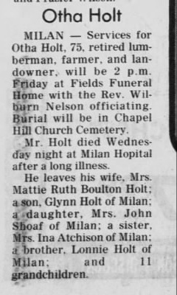
Born 1 May 1899 in Milan, Gibson, TN
Registered for the WWI draft 12 September 1918
  Medium height and build, Brown eyes, Dark hair
  Occupation: Farmer
  Next of kin: Mrs. D.A. Holt, Mother
Married Mattie Ruth Boulton 8 February 1922 in Gibson County
The Holts had 2 children – Maurine and Glynn
1930 Census: Family of 4, farming his own land
1940 Census: Family of 4, lumberman working for himself
Registered for WWII draft 16 February 1942
  5’11”, 230 lbs, Hazel eyes, Black hair, Dark complexion
  Next of kin: Mrs. Otha Holt, Wife
Otha died 27 May 1974 in Milan
Mattie Ruth died 15 August 1991 in Milan
Both are buried in Chapel Hill Cemetery in Milan
BROTHER: Otha John Holt

Slide 21
Otha’s Children
Ruth “Maurine”,1925-2017
Otha “Glynn”,1929-2013

Slide 22
What we know about Maurine
Born 6 March 1925 in Milan, Gibson, TN
Married John A. Shoaf 17 April 1947
1950 Census: John and Maurine lived next door to Maurine’s parents
  Occupation: John was a cotton buyer
The Shoafs had 7 children – John III, Barrett Holt, Camille, Richard Hedrick, Ruth, Nancy, Vance Charlton
John died 17 March 2002
Maurine died 17 April 2017
Both are buried in Oakwood Cemetery, Milan, TN

Slide 23
Maurine Holt Shoaf’s Children
John A. III, 1950
  2 Sons: John IV, Alex
Barrett Holt “Holt”, 1951
  2 Daughters: Jennifer Marie, Samantha Suellen
Camille, 1954
  Married Carl Mussenden
Richard Hedrick, 1957
  Married Frankie Woody, 1984
  1 Daughter: Emma Frances
Ruth, 1959
Nancy, 1963
  Married Art Graesser
Vance Charlton, 1965
  Married Julie Mansfield, 1997
  1 Son: Finis William

Slide 24
What we know about Glynn
Born 29 November 1929 in Milan, Gibson, TN
Glynn had 2 children – Diane, Mae – children from two different marriages
Holt & Holt Construction – floating concrete models
Glynn died 3 June 2013 in Milan
Buried in Chapel Hill Cemetery in Milan

Slide 25
Glynn Holt’s Children
Diane Holt
  2 Children: Christopher and Katherine Bansbach
Mae Holt
  1 Child

